Slide 1

BSBXCS404 – Contribute to cyber security risk management

Slide 2

Session 3 – 4
Review relevant critical cyber risk management strategies appropriate to level of risk

Slide 3
Getting started
Before we are able to review the relevant risk management strategies, we need to determine the level of risk.
This is commonly determined by a risk assessment.
By understanding the existing risk level, we can determine if the risk management strategies are appropriate, inadequate or overkill.

Slide 4
Threat and risk assessment (TRA)
Sometimes known as Threat, Vulnerability and Risk Assessments (TVRA)
Used to assess the risks that the asset register is exposed to.
Identifies and evaluates vulnerabilities by mapping the threats and resulting risks.
What is the difference between a risk, threat and vulnerability?

Slide 5
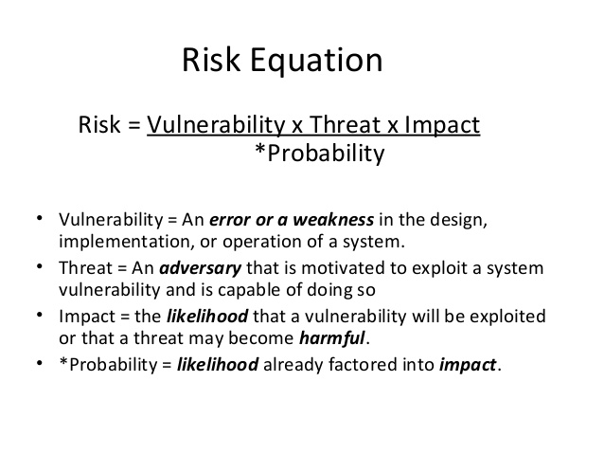

Slide 6
Categories of risk
Strategic risk is related to adverse business decisions, or the failure to implement appropriate business decisions in a manner that is consistent with the institution’s strategic goals.
Reputational risk is related to negative public opinion.
Operational risk is related to loss resulting from inadequate or failed internal processes, people, and systems, or from external events.
Transactional risk is related to problems with service or product delivery.
Compliance risk is related to violations of laws, rules, or regulations, or from noncompliance with internal policies or procedures or business standards.

Slide 7
Basic steps of a risk assessment
Characterise
Characterise the System (Process, Function, or Application)
Identify
Identify Threats
Determine
Determine Inherent Risk & Impact
Analyse
Analyse the Control Environment
Determine
Determine a Likelihood Rating
Calculate
Calculate your Risk Rating

Slide 8
1. CharacteriSe the System
What is it?
What kind of data does it use?
Who is the vendor?
What are the internal and external interfaces that may be present?
Who uses the system?
What is the data flow?
Where does the information go?

Slide 9
2. Identify the threats
Listing the potential threats relating to the system.
Common threats include:
Unauthorised access (malicious or accidental). This could be from a direct hacking attack / compromise, malware infection, or internal threat.
Misuse of information (or privilege) by an authorised user. This could be the result of an unapproved use of data or changes made without approval.
Data leakage or unintentional exposure of information. This includes permitting the use of unencrypted USB and / or CD-ROM without restriction; deficient paper retention and destruction practices; transmitting Non-Public Personal Information (NPPI) over unsecured channels; or accidentally sending sensitive information to the wrong recipient.
Loss of data. This can be the result of poor replication and back-up processes.

Slide 10
3. Determine inherent risk and impact
This step is done without considering your control environment.
Factoring in how you characterised the system, you determine the impact to your organisation if the threat was exercised.
Examples of impact ratings are:
High – Impact could be substantial.
Medium – Impact would be damaging, but recoverable, and / or is inconvenient.
Low – Impact would be minimal or non-existent.

Slide 11
4. Analyse the control environment
You typically need to look at several categories of information to adequately assess your control environment. Ultimately, you want to identify threat prevention, mitigation, detection, or compensating controls and their relationship to identified threats.
A few examples include:
Organisational Risk Management Controls
User Provisioning Controls
Administration Controls
User Authentication Controls
Infrastructure Data Protection Controls
Data Centre Physical & Environmental Security Controls
Continuity of Operations Controls

Slide 12
4. Analyse the control environment
Control assessment categories may be defined as:
Satisfactory – Meets control objective criteria, policy, or regulatory requirement.
Satisfactory with Recommendations – Meets control objective criteria, policy, or regulatory requirement with observations for additional enhancements to existing policies, procedures, or documentation.
Needs Improvement – Partially meets control objective criteria, policy, or regulatory requirement.
Inadequate – Does not meet control objective criteria, policy, or regulatory requirement.

Slide 13
5. Determine a likelihood rating
Now, you need to determine the likelihood of the given exploit taking into account the control environment that your organisation has in place. Examples of likelihood ratings are:
High – The threat-source is highly motivated and sufficiently capable, and controls to prevent the vulnerability from being exercised are ineffective.
Medium – The threat-source is motivated and capable, but controls are in place that may impede successful exercise of the vulnerability.
Low – The threat-source lacks motivation or capability, or controls are in place to prevent, or at least significantly impede, the vulnerability from being exercised.

Slide 14
6. Calculate your risk rating
Even though there is a ton of information and work that goes into determining your risk rating, it all comes down to a simple equation:
Impact (if exploited) * Likelihood (of exploit in the assessed control environment) = Risk Rating
Some examples of risk ratings are:
Severe – A significant and urgent threat to the organisation exists and risk reduction remediation should be immediate.
Elevated – A viable threat to the organisation exists, and risk reduction remediation should be completed in a reasonable period of time.
Low – Threats are normal and generally acceptable but may still have some impact to the organization. Implementing additional security enhancements may provide further defence against potential or currently unforeseen threats.

Slide 15
6. Calculate your risk rating
Using the values for impact and likelihood in the NIST Special Publication 800-30, here’s what a completed Residual Risk Rating Assessment could look like.
Identified Threat | Impact | Likelihood | Value | Risk Calculation
Unauthorised Access (Malicious or Accidental) | High [100] | High [1.0] | 100*1.0=100 | Severe
Misuse of Information by Authorised Users | High [100] | Medium [.5] | 100*.5=50 | Elevated
Data Leakage / Unintentional Exposure of Customer Information | High [100] | Medium [.5] | 100*.5=50 | Elevated
Failed Processes | High [100] | Low [.1] | 100*.1=10 | Low (Normal)
Loss of Data | High [100] | Low [.1] | 100*.1=10 | Low (Normal)
Disruption of Service or Productivity | High [100] | Low [.1] | 100*.1=10 | Low (Normal)

Slide 16
Threat and Risk assessment software
Risk management software, is designed to lower the overall risk and security implications that enterprises face.
Works by identifying the risks associated with a given set of assets and communicating this risk to the business, often through on-screen dashboards.
Collecting and collating data across the enterprise IT system to indicate where the risks lie.

Slide 17
Next Session…..
Once we have determined the existing level of risk, we can now move on to review existing risk management strategies to determine if they are sufficient and appropriate.
We will look at the key risk management strategies next week.

Slide 18
Questions?

